Slide 1


European League
Datawis

Slide 2
TABLE OF CONTENTS
01
02
03
04
Introduction
Problem Statement Overview
Problem 1- What Makes a Top team
Problem 2 What Makes a Bottom team
05
06
07
Problem 3 Top Impact players
Final Takeaways & Insights
Problem 4
Predicted league Winner

Slide 3


Introduction
Analyzes football performance data to uncover patterns behind team success
Covers five major European leagues: Premier League, La Liga, Bundesliga, Serie A, and Ligue 1
Uses a combination of team-level standings and individual player statistics
Integrates multiple datasets including standings, fixtures, and player_Stats
Focuses on understanding both offensive and defensive performance attributes
Applies data preprocessing, feature engineering, and machine learning models
Aims to support data-driven strategy development in professional football
Builds a foundation for predictive modeling of team and player outcomes

Slide 4

Overview Of problem Statement
Top Teams What attributes (offensive or defensive) are inherent to teams that finish at or near the top of the league table?
Bottom Teams What characteristics are common among teams that finish at the bottom of the standings?
Player Contributions Which players contribute most to team success, and what percentage of a team’s goals come from them?
Champion Prediction Can we build a machine learning model to accurately predict the league champion based on team and match performance?

Slide 5
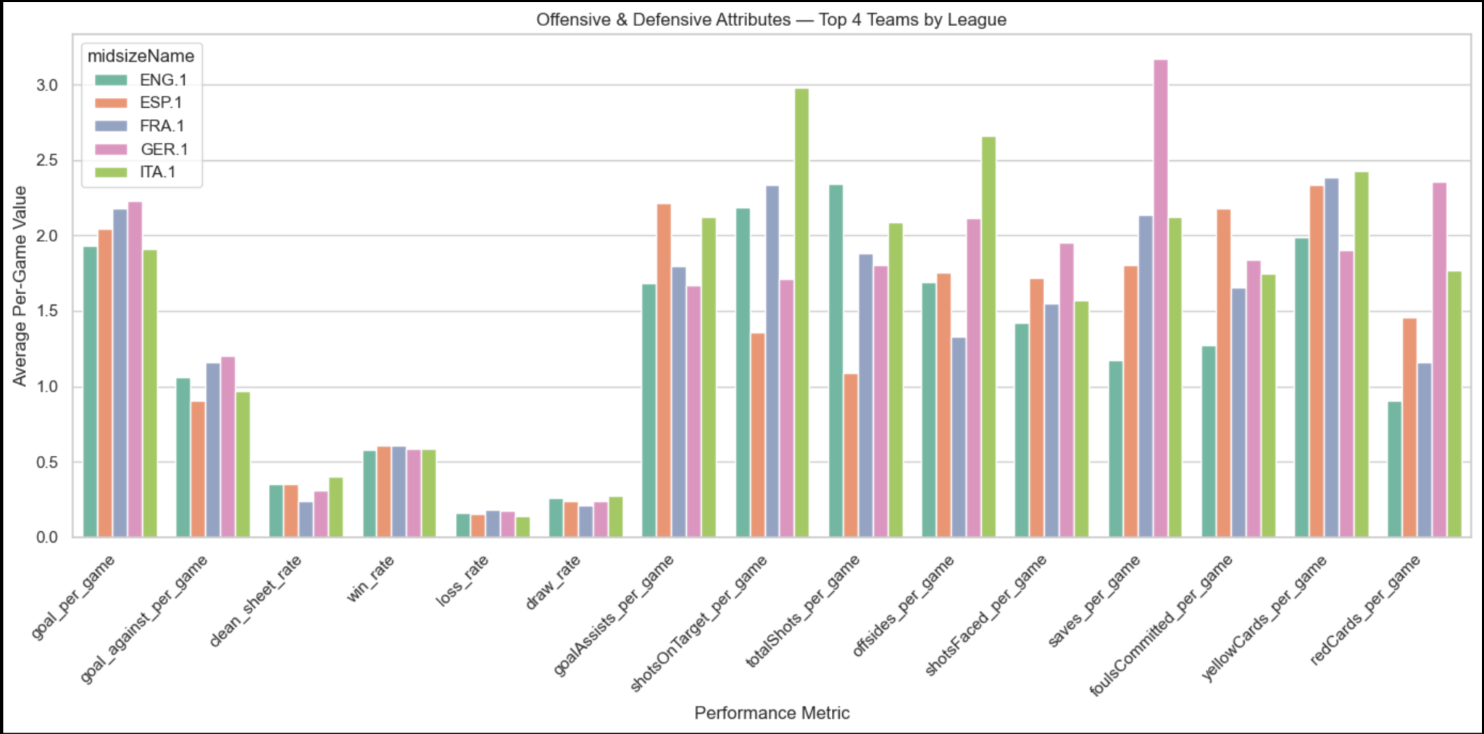
Problem
01
What performance attributes define teams that finish at the top of the league table?

Slide 6
Problem
01
Top teams score the most goals per game
All five leagues show high goal_per_game values for top 4 teams, especially Ligue 1 (FRA.1) and La Liga (ESP.1), meaning consistent offensive strength.
They allow fewer goals than they score goal_against_per_game is noticeably lower across the board, especially in Premier League (ENG.1) and Bundesliga (GER.1), showing strong defensive setups.
Higher win rates with fewer losses The win_rate bars are significantly taller than loss_rate, confirming that top teams dominate most of their matches.
More goal assists and shots on target
Metrics like goalAssists_per_game and shotsOnTarget_per_game are consistently high, showing that these teams not only finish well but also build attacks with support and precision.

Slide 7
Problem 02: Attributes For Bottom Teams
Weak Defense Across Leagues Goal against per game is consistently above 1.8, especially in ENG.1 & FRA.1 — bottom teams are leaking goals.
High Pressure on Goalkeepers Shots Faced per game is very high (peaking at 2.9), but clean sheet rates remain close to zero — defense isn’t holding.
Few Assists & Poor Shot Accuracy While total Shots per game is decent, goal_Assists and shots On Target lag — indicating poor shot selection or execution.
Discipline Issues GER.1 & ENG.1 bottom teams show elevated fouls and cards — highest yellow and red card rates across all leagues.

Slide 8
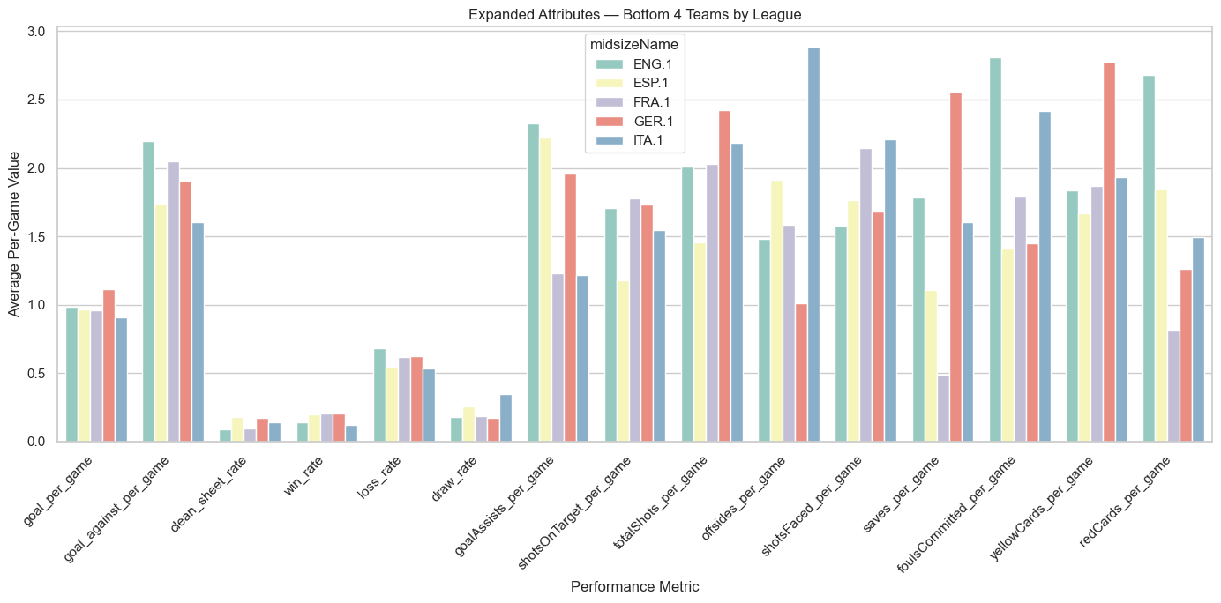
Problem
02

Slide 9

03
TOP IMPACT PLAYERS

Slide 10
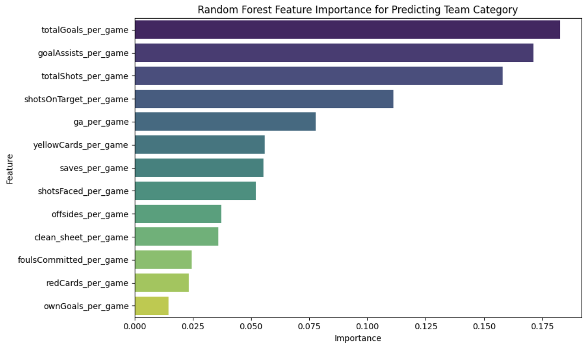
FEATURE IMPORTANCE

Slide 11
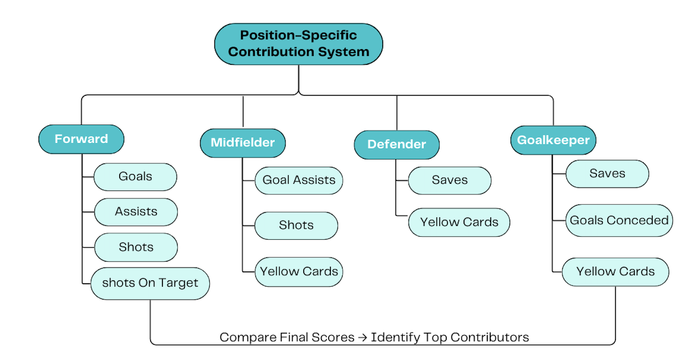
How to measure players’ contribution?

Slide 12
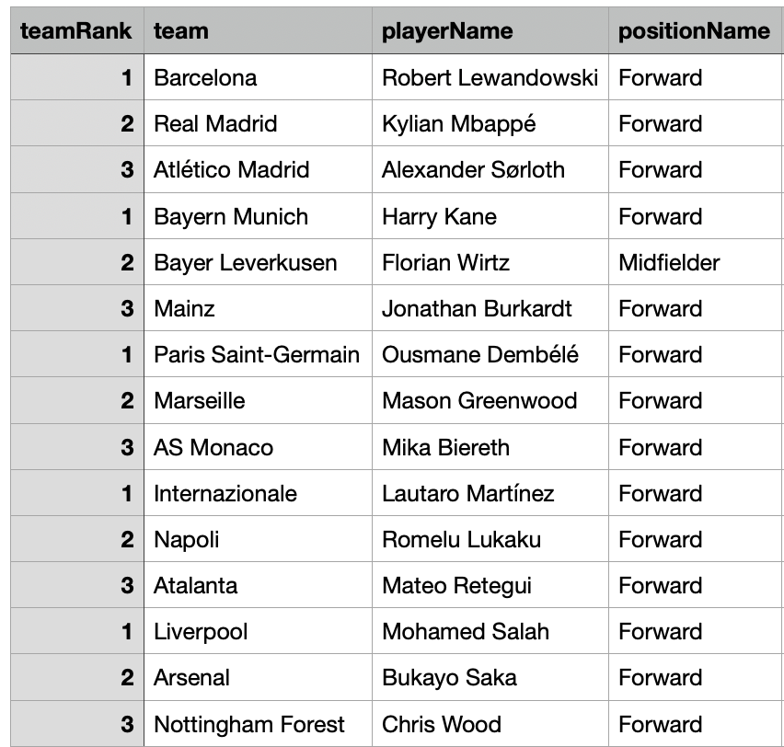
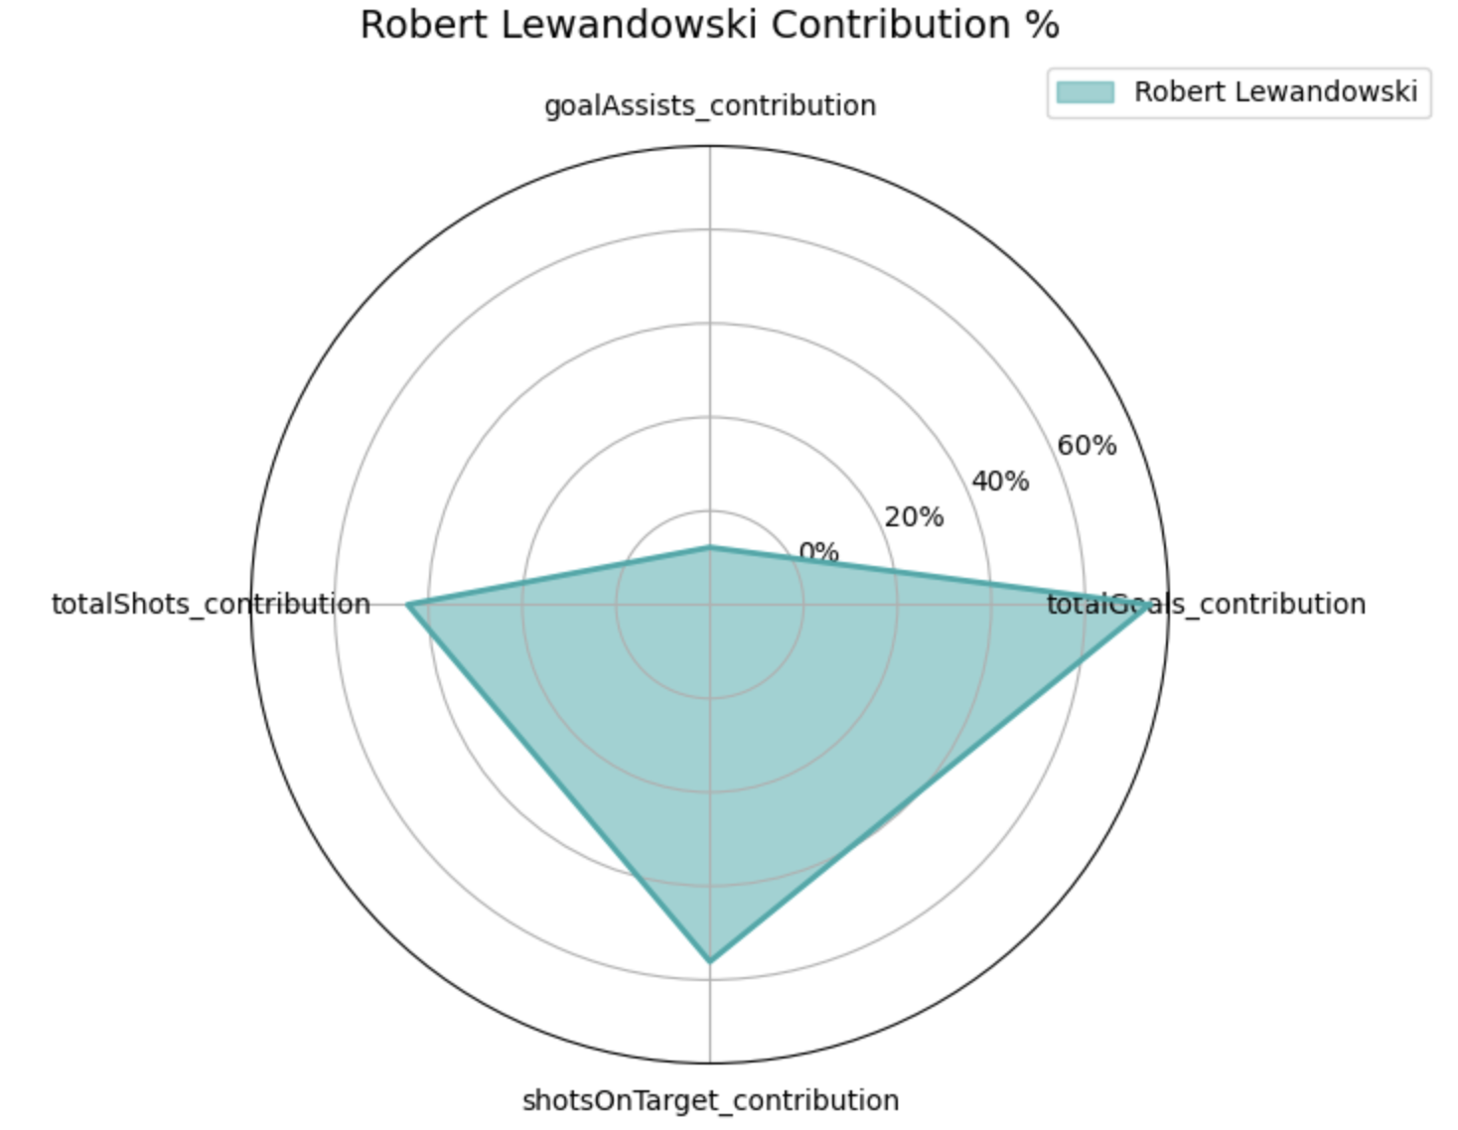
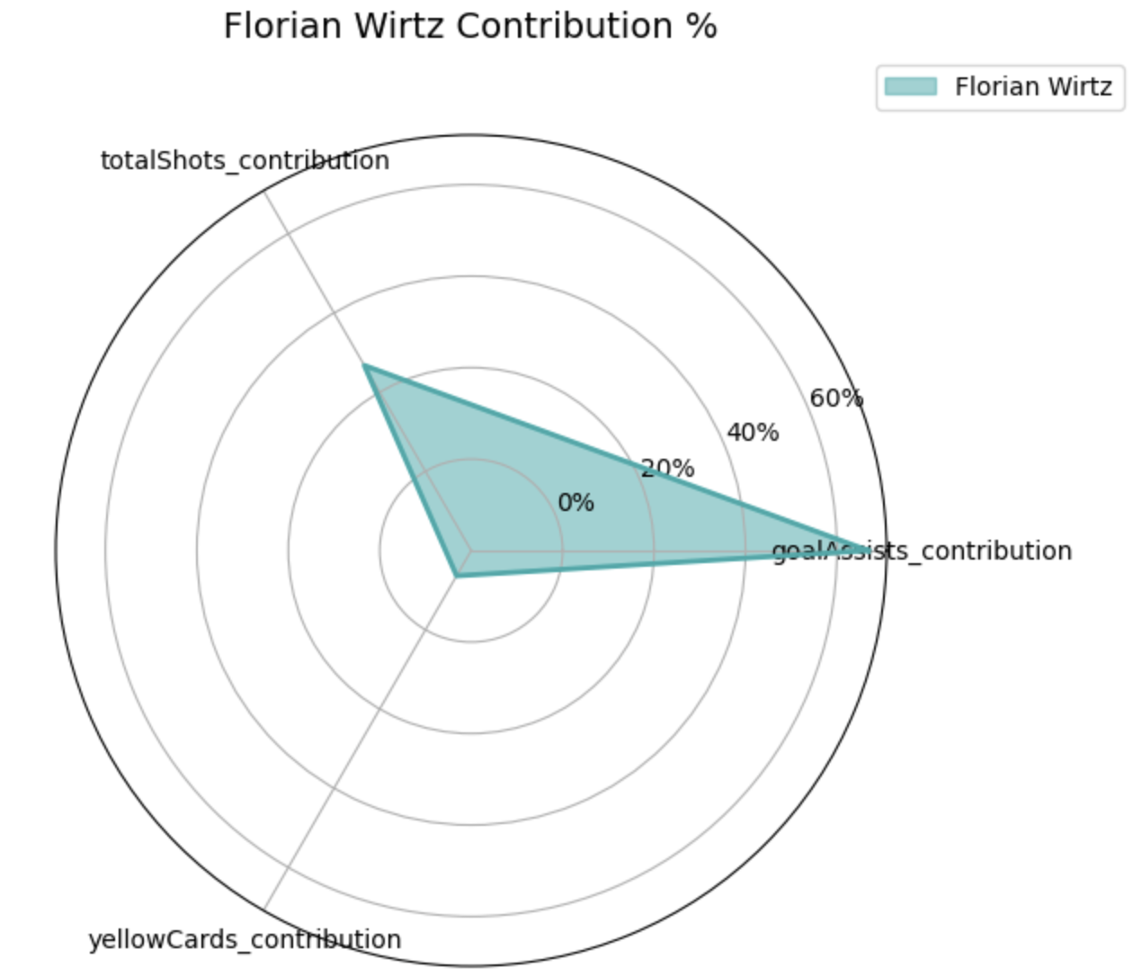
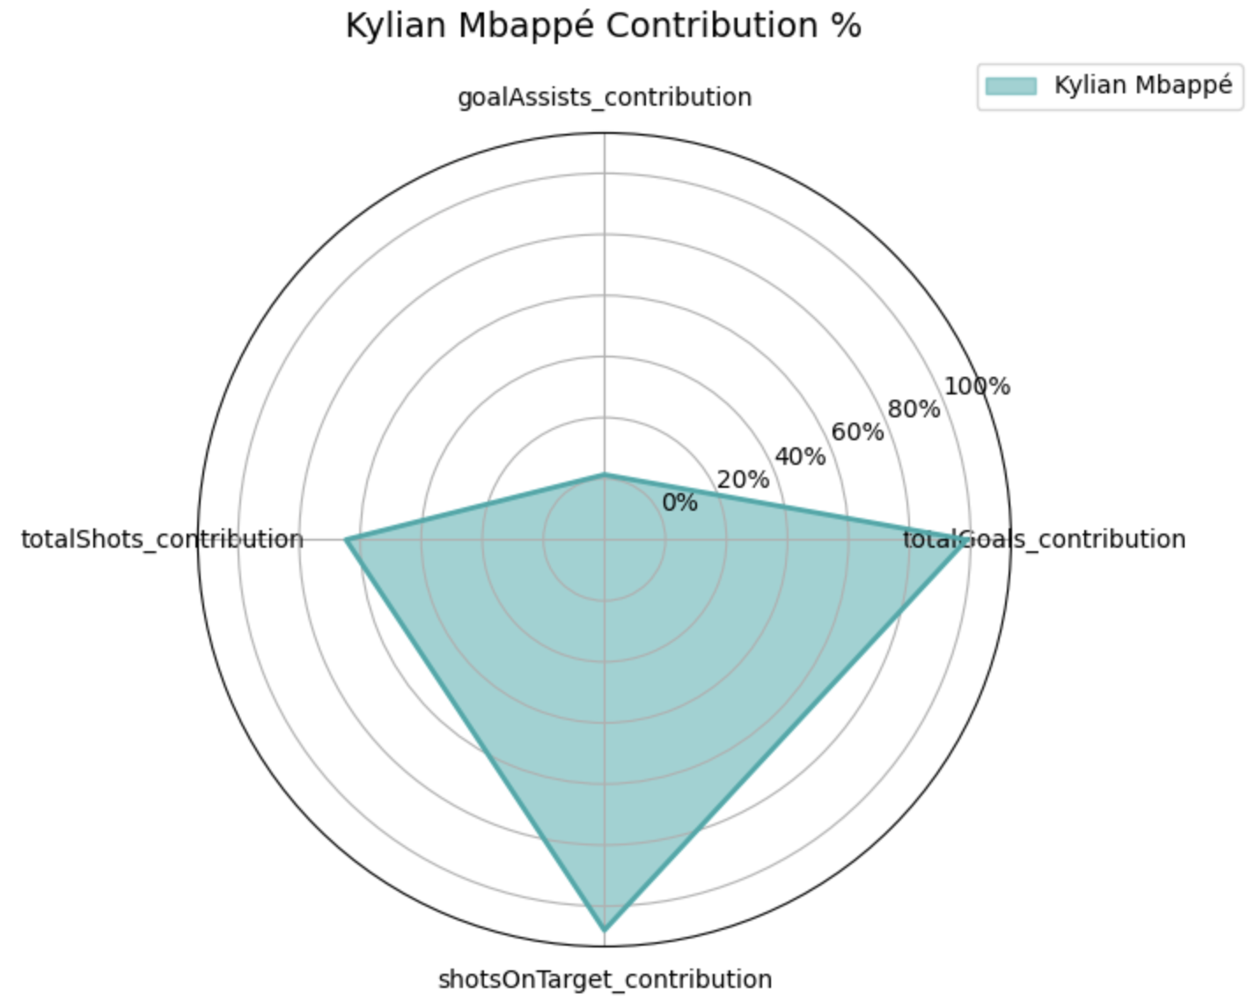
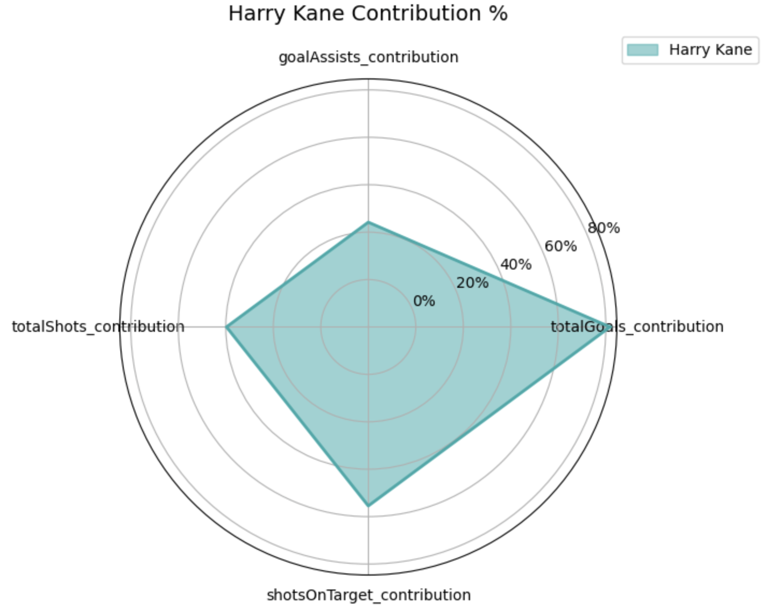
Top Contributors

Slide 13

04
PREDICTED LEAGUE WINNERS

Slide 14
VICTORY PREDICTION SYSTEM
Win Probability
TEAM STRENGTH
EXTERNAL FACTORS
Defense
Offense
Home team
Away team
Saves…
Goals, Goal assist, Shots on Target…
Home win rate
Away win rate

Slide 15
FEATURE IMPORTANCE

Slide 16

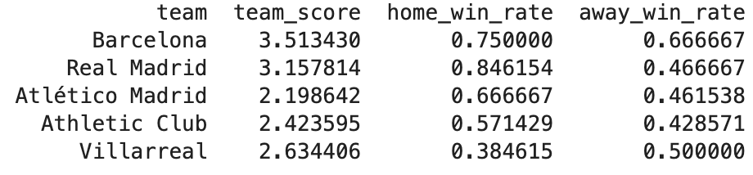
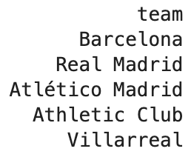
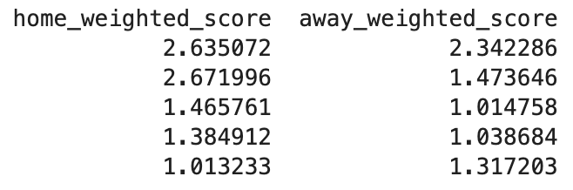
PREDICTING VICTORY
LOSE
Draw
WIN
-1 point
1 point
3 points
45% 55%

Slide 17
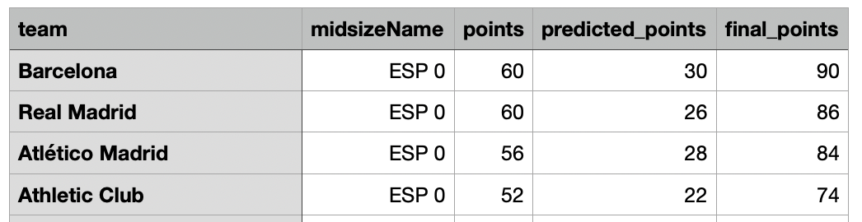
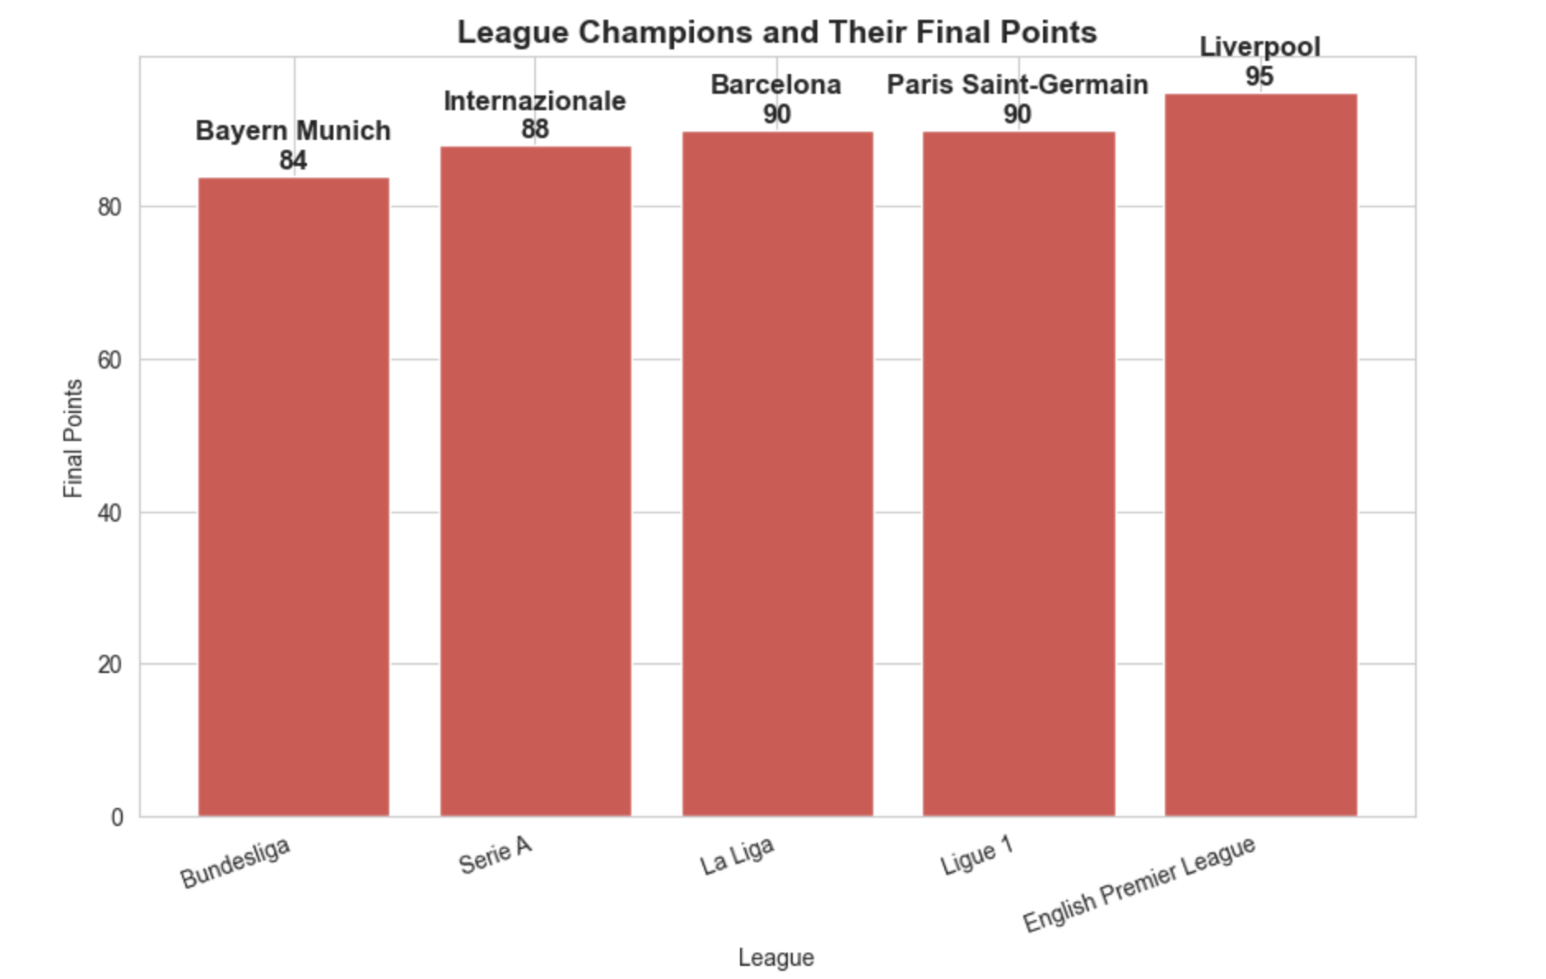

Slide 18
Final Takeaways & Insights
Top teams win by maintaining scoring momentum and strong defenses.
Bottom teams struggle with both shot creation and goal prevention.
Player impact scores help identify top contributors across leagues.
ML modeling predicts champions based on per-game stats with high confidence.
Data isn't just numbers — it's the strategy behind every win.

Slide 19

THANK YOU!

